Slide 1
Generating noisy speech data from clean data in the frequency domain using Deep Learning Methods
Week – 4
Name: Shashank Shirol
University: Manipal Institute of Technology
Duration of the presentation: ~10 mins.

Slide 2
Tasks to be completed:
Redo the reconstruction code. Make use of python libraries available (librosa).
Demonstrate how the spec info is being preserved through the transformations from spec → spec image → SinGAN → spec image → spec.
Modify code to preserve orientation of the spectrogram, i.e. Low frequencies at the bottom, high frequencies at the top.
Implement LSD (Log-Spectral Distance) with Normalization to compare output of SinGAN with Ground truth.
Train SinGAN on RATs Noise with new extraction and reconstruction code and document results.
Train SinGAN on Ffmpeg passed samples and document results.
Try mel-scale spectrograms and the in-built reconstruction module for a mel-spec
Try training SinGAN with Long Specs from the RATs corpus. Document results.

Slide 3
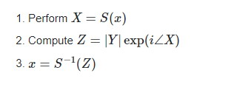
How is the spec extracted and reconstructed?
Theoretically:
x → Signal
S → STFT operator
|Y| → Magnitude of the STFT
Programmatically:
#extraction
data, sr = librosa.load(filename, sr=None)
comp_spec = librosa.stft(data, n_fft=n_fft) mag_spec, phase = librosa.magphase(comp_spec)
phase = np.angle(phase)
#reconstruction
temp = mag_spec * np.exp(phase * 1j)
data_out = librosa.istft(temp)

Slide 4
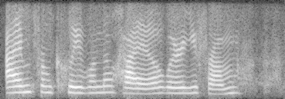
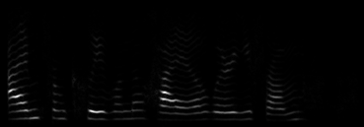
How is the spec stored as an Image and then restored from the Image form (I):
Convert to decibel (dB) units. (log based because, the power version loses info when scaling to 0-255) Use: librosa.power_to_db(S)
Then the spec goes through the old pipeline, of scaling between 0-255 then to SinGAN for training and then back to the power form. Following images show that the loss of info is very minimal.
Log-based when stored
Non Log-based when stored

Slide 5
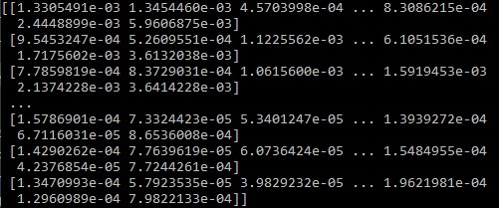
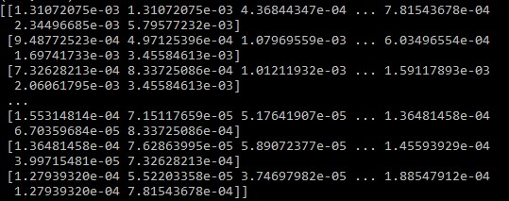
How is the spec stored as an Image and then restored from the Image form (II):
Mag. Spec to be saved as image
Mag. Spec retrieved from an image
Retrieved after putting the image through the un-scaling method
The mag. Spec retrieved is reconstructed as seen previously

Slide 6
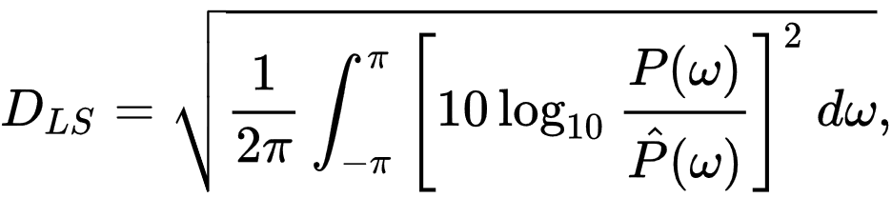
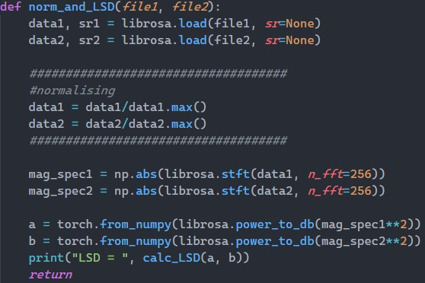
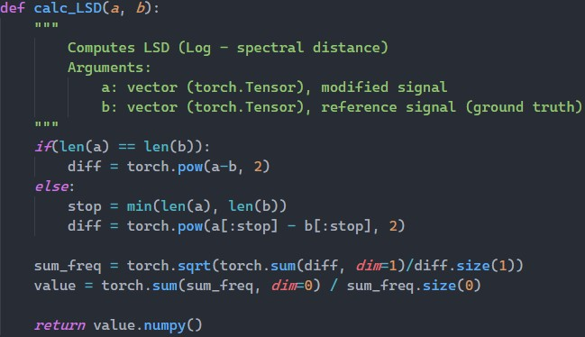
Log-Spectral Distance (I):
LSD Implementation^{[1]}
[1] https://github.com/nanahou/metric/blob/master/measure_SNR_LSD.py

Slide 7

Log-Spectral Distance (II):
Testing the validity of the LSD implementation: LSD = 0.4967
Testing the need for Normalization: LSD (without Normalization): 10.1062 LSD (with Normalization): 0.6920
Original audio
reconstructed audio from its spectrogram
Original audio
Original audio, but 2x louder
Note: LSD between original audio and old reconstruction was about 3.05

Slide 8
Training SinGAN with RATs Sample with new extraction and reconstruction code:
Training Image: RATs Female Noisy (8k) Paint Image: RATs Female Clean (8k) Content: Different
Scale=5 output
Training Audio:
LSD between ground truth noise and output at:
start_scale=1: 15.103
start_scale=2: 15.345
start_scale=3: 16.991
start_scale=4: 17.489
start_scale=5: 17.787
LSD between paint and out put at:
start_scale=1: 11.098
start_scale=2: 9.267
start_scale=3: 5.313
start_scale=4: 2.970
start_scale=5: 2.573
Observation: LSD decreases, output and paint resembles but SinGAN fails (in its current implementation) to capture the characteristics of the ground_truth noise.
Scale=1 output
Ground Truth:
Paint Audio:

Slide 9
LSD with the old extraction and reconstruction code:
LSD between ground truth noise and output at:
start_scale=1: 14.119
start_scale=2: 14.118
start_scale=3: 15.561
start_scale=4: 16.172
start_scale=5: 17.206
start_scale=6: 17.382
start_scale=7: 17.743
LSD between paint and out put at:
start_scale=1: 13.078
start_scale=2: 13.361
start_scale=3: 10.720
start_scale=4: 8.712
start_scale=5: 7.942
start_scale=6: 7.192
start_scale=7: 6.329
Observation: SinGAN trains more scales, the LSD is lower at scale=1 than when SinGAN trains 5 scales under new implementation. But even with more scales, the LSD between paint and output doesn’t decrease significantly as seen with new implementation.

Slide 10
Training SinGAN with Ffmpeg samples (I):
Training Image: Female ogg (8k sampling rate, 5.5k bitrate) Paint Image: RATs Female Clean (8k sampling rate) Content: Different
Scale=5 output
LSD between ground truth noise and output at:
start_scale=1: 15.787
start_scale=2: 9.950
start_scale=3: 8.685
start_scale=4: 8.646
start_scale=5: 8.460
LSD between paint and output at:
start_scale=1: 14.353
start_scale=2: 7.900
start_scale=3: 5.602
start_scale=4: 3.677
start_scale=5: 2.484
Observation: LSD decreases in both cases (opp. of RATs case), output and paint resembles AND ground_truth and paint resembles too (this was not the case in RATs example). The noise characteristics are not captured by SinGAN, it just reproduces the paint image.
Training Audio:
Scale=1 output
Ground Truth:
Paint Audio:

Slide 11
Training SinGAN with Ffmpeg samples (II):
Training Image: Female g726 (8k sampling rate, 16k bitrate) Paint Image: RATs Female Clean (8k sampling rate) Content: Different
Scale=5 output
LSD between ground truth noise and output at:
start_scale=1: 18.842
start_scale=2: 18.732
start_scale=3: 17.182
start_scale=4: 14.330
start_scale=5: 10.067
LSD between paint and out put at:
start_scale=1: 15.278
start_scale=2: 13.077
start_scale=3: 10.320
start_scale=4: 6.874
start_scale=5: 3.016
Observation: Same as Example (I)
Training Audio:
Scale=1 output
Ground Truth:
Paint Audio:

Slide 12
Mel-Spectrogram (I):
Compute a Mel-Scaled spectrogram and inverse module to get audio back: Use: librosa.feature.melspectrogram(data, sr=None) Use: librosa.feature.inverse.mel_to_audio(M, sr=None)
Observation: The module that reconstructs the audio from a mel-spectrogram does so using Griffin-Lim^{[2]}.The reconstruction is lossy (refer next figure).
From the Librosa Documentation[3]: “Given a short-time Fourier transform magnitude matrix (s) , the algorithm randomly initializes phase estimates, and then alternates forward- and inverse-STFT operations. ”
[2] D. W. Griffin and J. S. Lim, “Signal estimation from modified short-time Fourier transform,” IEEE Trans. ASSP, vol.32, no.2, pp.236–243, Apr. 1984.
[3] https://librosa.org/doc/main/generated/librosa.griffinlim.html#librosa.griffinlim

Slide 13
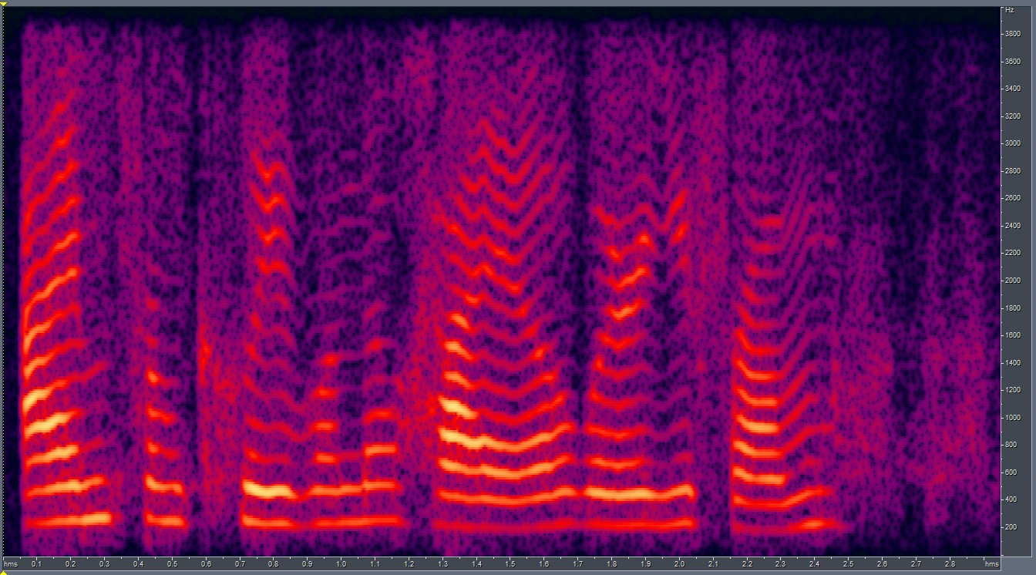
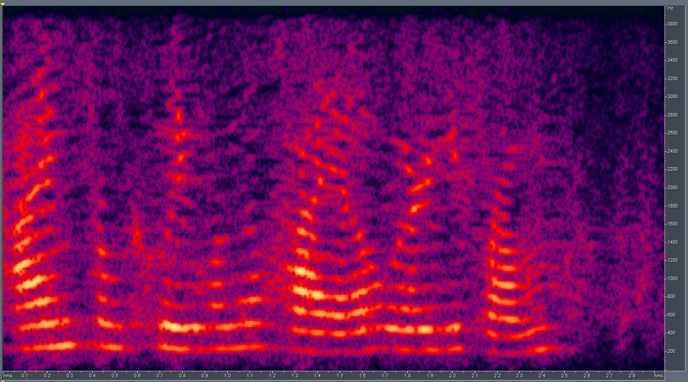
Mel-Spectrogram (II):
Original Audio:
Reconstructed Audio:

Slide 14
Training SinGAN with long RATs sample specs (I):
Training Image: 1 + 2 + 3(8k sampling rate) Paint Image: RATs Female Clean (8k sampling rate) Content: Different
1
Training Audio:
2
LSD between ground truth noise and output with 3 RATs noisy files concatenated at:
start_scale=1: 15.042
Observation: Only one scale is trained for the training spec of 3 concatenated files (~8 sec).
Similar results at Scale = 1 than at Scale=1 with one RATs noise audio (~2sec)
LSD between Output and paint image:
start_scale=1: 8.1566
3
Ground Truth:
Paint Audio:

Slide 15
Training SinGAN with long RATs sample specs (II):
Training Image: 1 + 2(8k sampling rate) Paint Image: RATs Female Clean (8k sampling rate) Content: Different
1
Training Audio:
2
LSD between ground truth noise and output with 2 RATs noisy files concatenated at:
start_scale=1: 17.337
start_scale=2: 17.346
start_scale=3: 17.328
Observation: LSD remains almost same at all the learned scales. influence of paint image is more than the training image in generation. The scales generate most paint-like images.
LSD between Output and paint image:
start_scale=1: 10.920
start_scale=2: 5.628
start_scale=3: 3.534
Ground Truth:
Paint Audio:

Slide 16
End.

